Slide 1
Image Captioning Using VIT-GPT2 on Flickr8K
Team 7 Atharva Patil - 1002138260 Manan Arora - 1002143328 Harshal Devi - 1002172497

Slide 2
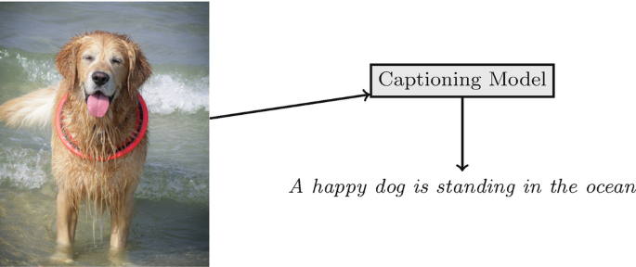
Background
Image Captioning combines Computer Vision and Natural Language Processing (NLP)
The goal is to automatically generate textual descriptions for images
Transformer-based models have significantly improved captioning quality
Applications include accessibility tools, automatic photo tagging, and content creation

Slide 3
Project Motivation
Explore modern pre-trained models for generating image captions.
Understand the performance of Vision Transformers combined with language models.
Evaluate caption quality using BLEU scores.
Gain practical experience with real-world datasets and deep learning workflows.

Slide 4
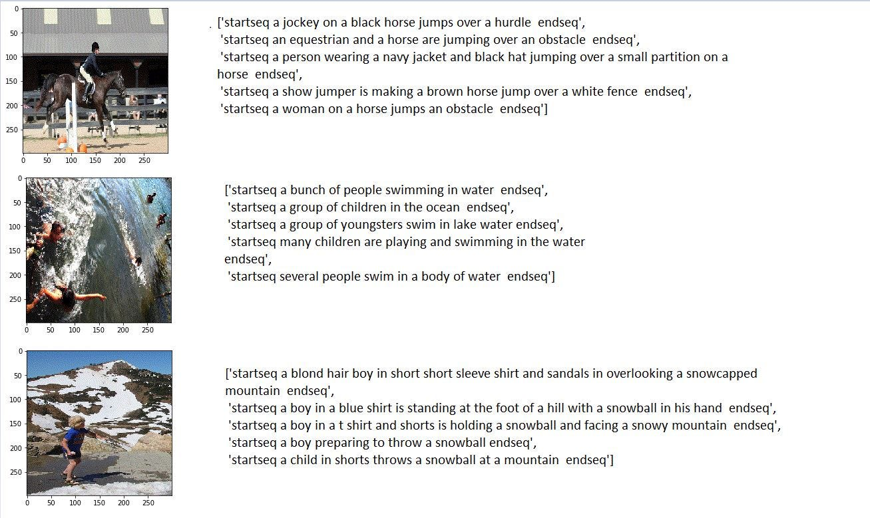
Dataset : Flick8k
Flickr8k dataset contains 8,000 images with 5 captions per image.
Captions describe objects, actions, and scenes in the images.
Dataset split into training, validation, and test sets.
Each caption uses simple and descriptive English sentences.

Slide 5
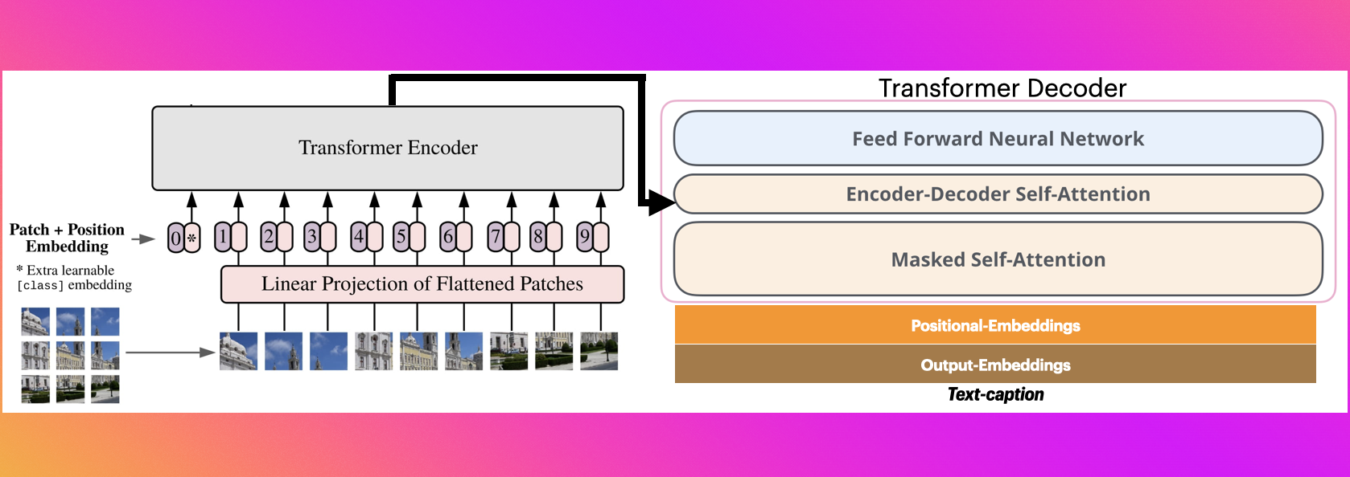
Method
Used pre-trained model: nlpconnect/vit-gpt2-image-captioning from Hugging Face.
Vision Transformer (ViT) extracts visual features from images.
GPT2 decoder generates captions based on the extracted features.
Added a distinct padding token to properly format model outputs.
Captions generated using beam search decoding with multiple beams.

Slide 6
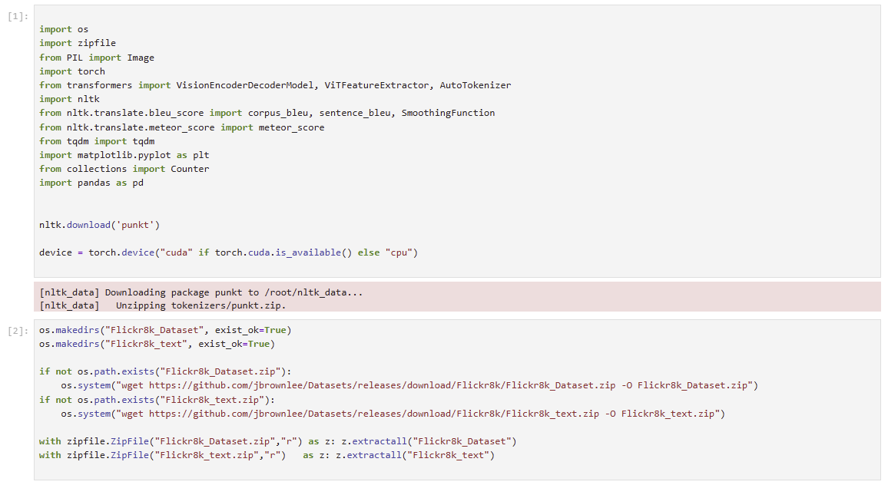
Code Snippets
Downloaded and extracted Flickr8k dataset and captions.

Slide 7
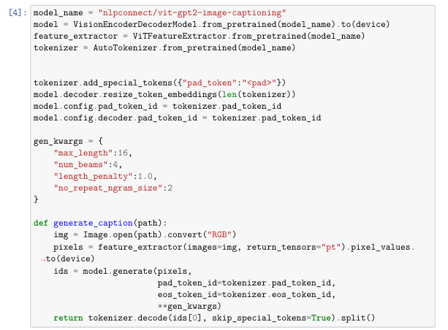
Code Snippets
Loaded pre-trained VisionEncoderDecoderModel (ViT + GPT2)

Slide 8
Code Snippets
Created a function $generate_caption\left(path\right)$ to predict captions

Slide 9
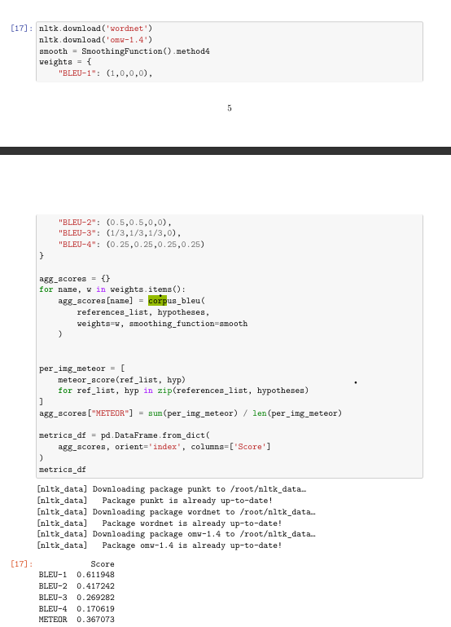
Code Snippets
Evaluated model performance using BLEU-1 to BLEU-4 scores.

Slide 10
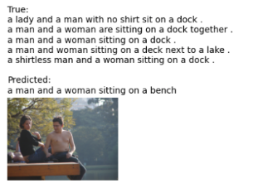
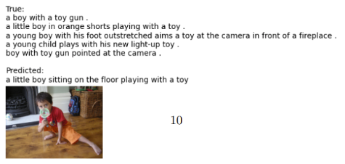

Experiments and Results
Model evaluated on the Flickr8k Test Set.
BLEU Scores Achieved:
BLEU-1: 0.6119
BLEU-2: 0.4172
BLEU-3: 0.2693
BLEU-4: 0.1706
True vs Predicted captions visualized on sample test images.
METEOR Score : 0.3670
Captions generally matched main objects and actions in images.

Slide 11
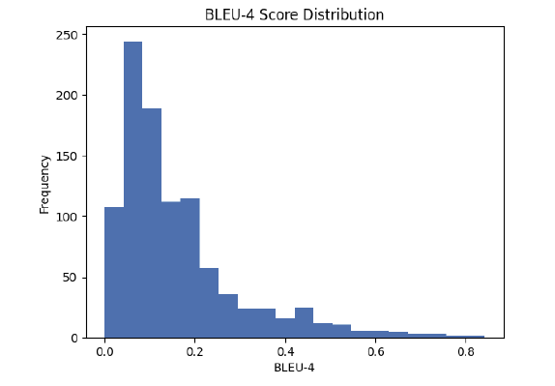

Slide 12
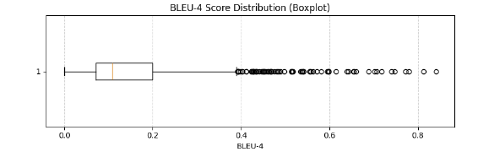

Slide 13
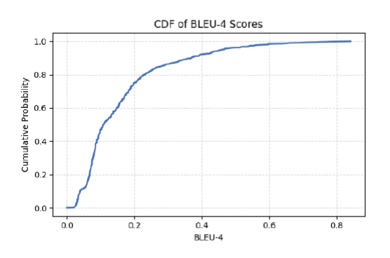

Slide 14
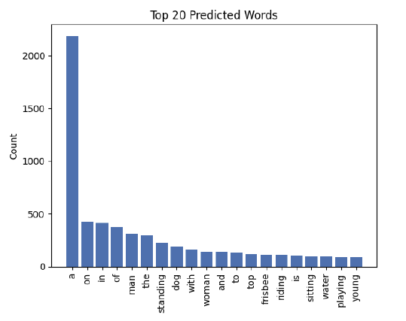

Slide 15
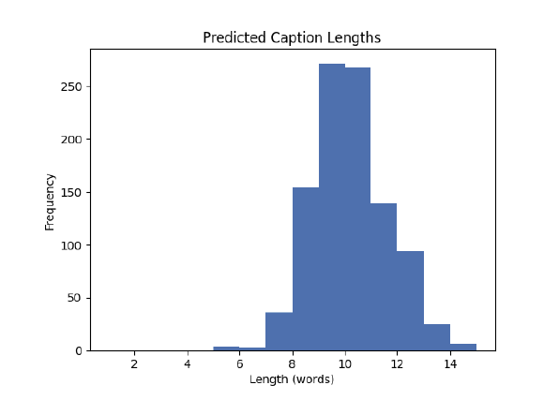

Slide 16
Strengths ✅ | Weaknesses ⚠️
High-quality captions with correct object identification | Captions are sometimes too generic
Good handling of simple scenes and actions | Struggles with complex scenes involving multiple activities
No fine-tuning required for decent results | Limited vocabulary and descriptive richness

Slide 17
Future Work
Fine-tune the model on larger and more diverse datasets.
Experiment with newer decoding strategies like top-k sampling or nucleus sampling
Incorporate attention visualization techniques
Integrate multimodal pretraining approaches (e.g., CLIP) for richer context understanding.

Slide 18
References
Flickr8k Dataset: https://github.com/goodwillyoga/Flickr8k_dataset?tab=readme-ov-file
Model (ViT-GPT2): https://huggingface.co/nlpconnect/vit-gpt2-image-captioning
BLEU Score Evaluation: NLTK Documentation https://www.nltk.org/

Slide 19
Questions ?

